Slide 1
Environmentally Responsible Cleaning – helping to stop the damage
“Our concern is the environment. Our passion is helping you protect it for the future”.
Presentation author – Graeme Warnell 09.10.2020

Slide 2
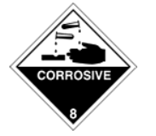
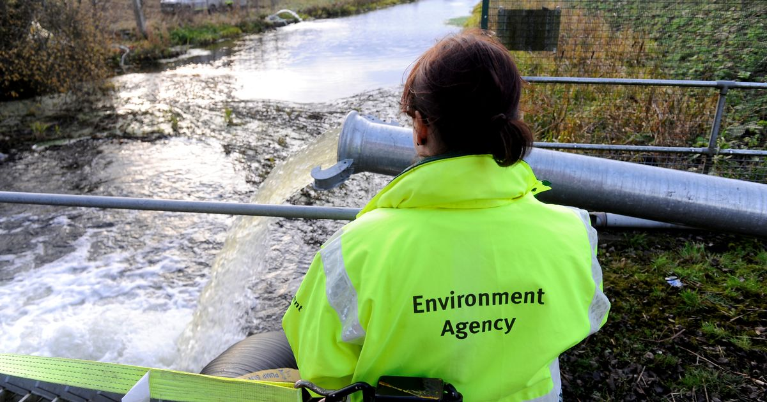
The Problem
In September 2020 the Environment Agency released figures that show that every UK monitored surface water body failed standards for chemical pollution.
None of them were given and overall clean bill of health.
Water quality affects our crops, our wildlife, the nature sites we love to visit, our water bills and so much more.
The UK needs to reduce the amount of chemically toxic products that enter our waterways and public sewers.
Remember, eventually we all end up drinking this reprocessed poor-quality water and not all the chemicals can be removed.
“ English river quality is the worst in Europe” - Dr Janina Gray, head of science and policy at salmon and trout conservation.
“We need to go further and faster on reducing the environmental impact from storm overflows and other sources of pollution including chemicals and agriculture” - Rebecca Pow, Environment Minister .

Slide 3
The Solution
Unfortunately we cannot remove all harmful chemicals from our cleaning processes.
BUT we can evaluate if they are truly the only option available to us and where possible replace with non-chemical products.
This can be achieved at every level, from industrial manufacturing to our own homes.
Just as chemicals have a toxic accumulation effect on our water quality , non-chemical cleaning products can have a positive effect on our water quality and natural bio diversity.
If you are using chemical cleaning products then you are unknowingly contributing to the UK natural water quality problem.
If we reduce the amount of chemically toxic products entering our water, this is a massive step forwards.
If we replace it with non-chemical, bioremedial cleaning products, we are putting essential, naturally occurring, harmless bacteria back into our water ways.
Bacteria that are an essential part of the eco –system.
“Our concern is the environment. Our passion is helping you protect it for the future”.

Slide 4
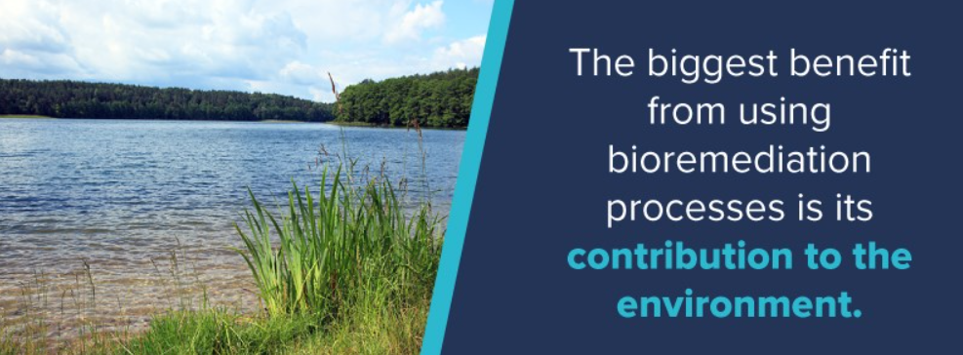
The Technology
Our non-chemical cleaning products are a specially formulated blend of natural surfactant and naturally occurring augmented bacteria.
The powerful natural surfactants are readily biodegradable and they uplift grease and dirt from any hard surface.
The naturally occurring bacteria then ingest fats, grease and oils converting them into water and naturally occurring CO2 which is essential for photosynthesis.
By using naturally occurring bacteria we are enhancing nature’s own process of dealing with contamination and converting it into a powerful and harmless non-chemical cleaning product.

Slide 5
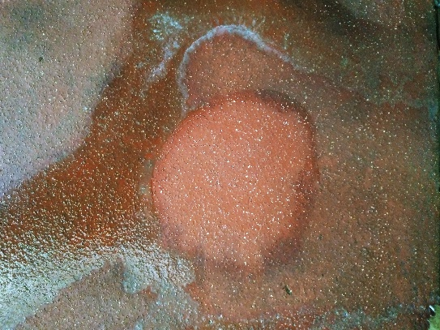
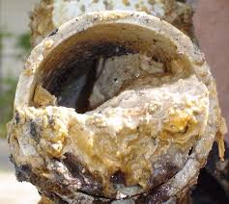
The Benefits
At GW Environmental we know replacing harmful and toxic cleaning products with our products will help improve UK water quality.
We make our products price competitive so they represent a replacement cost or cost saving and not an additional cost to you.
Our products are non-chemical, non-caustic and Ph neutral so they are safer for you to use.
The regular use of our products will help even the most difficult to clean hard surfaces retain their original non slip design.
The ability of our products to ingest fats, oils and grease means that drains can be kept free running with “good” bacteria entering the sewers to help prevent wider social and economic issues, such as the creation of fatbergs.
We supply our products in a concentrated formula to reduce storage needs and the CO2 footprint associated with delivery and distribution.
The cost of slip and trip related injuries cost the NHS £133m per annum.
They accounted for 698,336 bed days .
Hospital Episode Statistics - England: financial year 2002-03
The UK spends over £100m a year removing over 300 00 fatbergs from drains and sewers .
lanes for drains –commercial news facts-fatbergs
The UK Cleaning Council is now raising concerns over the detrimental long term effects of chemical cleaning products on individuals

Slide 6
At GW Environmental we are so concerned about the state of UK lakes and rivers we will help you start that journey from chemical to non-chemical cleaning products FOR FREE
If you want to contribute positively to the environment or just want some peace of mind, we will evaluate your existing cleaning products and processes and recommend a way forwards for you
When it comes to the future of our waterways and the natural environment, we all have a choice as to how we contribute
“Our concern is the environment. Our passion is helping you protect it for the future”.
GW Environmental & Consulting Ltd
Registered Company - 11968131
Email: info@gwenvironmentalconsulting.com
www.gwenvironmentalconsulting.com

